Slide 1

The Golden Rule

Slide 2
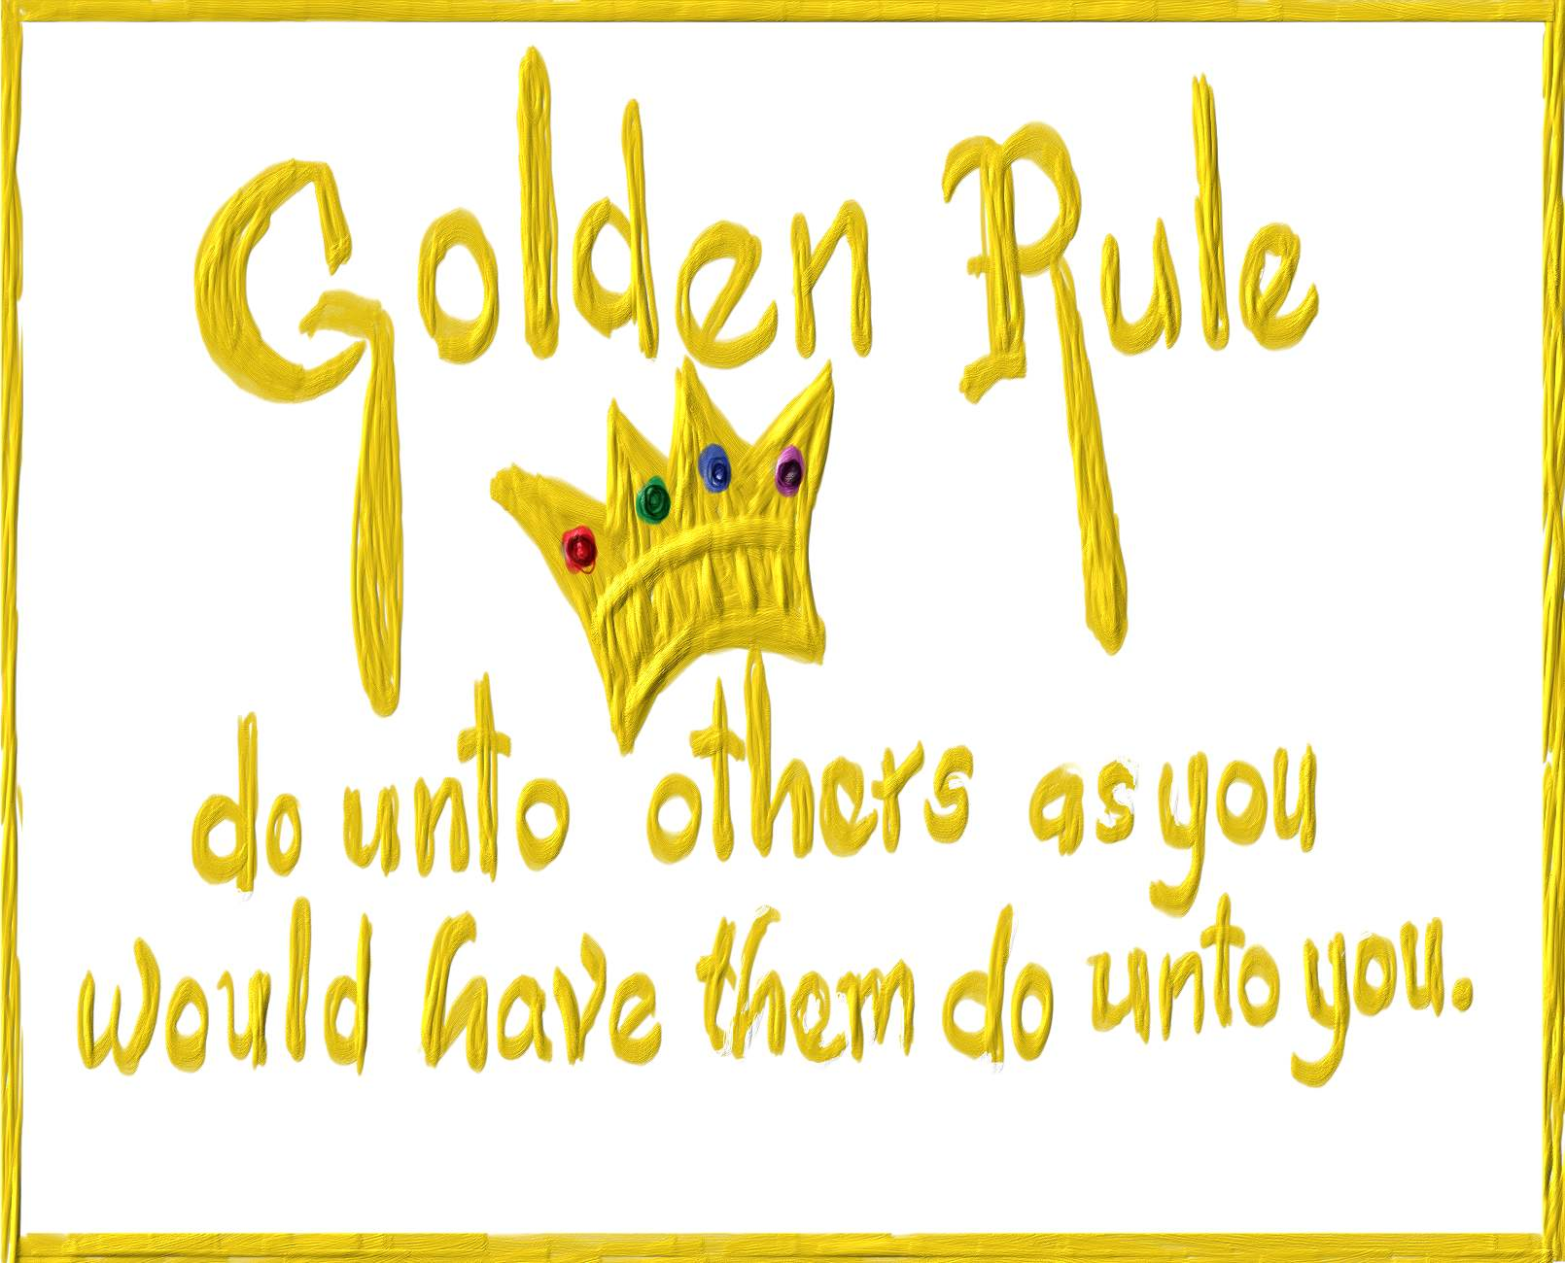
Notes:
Can we solve the problem with a single, simple rule?
https://marquetteeducator.files.wordpress.com/2013/12/golden-rule.jpg

Slide 3
The Golden Rule
Christianity All things whatsoever ye would that men should do to you, do ye so to them; for this is the law and the prophets. Matthew 7:1
Confucianism Do not do to others what you would not like yourself. Then there will be no resentment against you, either in the family or in the state. Analects 12:2
Buddhism Hurt not others in ways that you yourself would find hurtful. Udana-Varga 5,1
Hinduism This is the sum of duty; do naught onto others what you would not have them do unto you. Mahabharata 5,1517
Islam No one of you is a believer until he desires for his brother that which he desires for himself. Sunnah
Judaism What is hateful to you, do not do to your fellowman. This is the entire Law; all the rest is commentary. Talmud, Shabbat 3id
Taoism Regard your neighbor’s gain as your gain, and your neighbor’s loss as your own loss. Shang Kan Yin P’ien
Zoroastrianism That nature alone is good which refrains from doing another whatsoever is not good for itself. Dadisten-I-dinik, 94,5
Notes:
But what happens if people are in different roles. I don’t need anyone to bring me food. So does that mean I have no responsibility to bring food to anyone else, even my children?
What if not everyone wants what you want. Suppose you are happy to give your software away free. Does this mean you can steal someone else’s? (Tavani, p 48)
Or this: Someone on your engineering team is grossly incompetent and is putting the whole project at risk. You consider reporting him. But you don’t because, if you were incompetent, you wouldn’t want to be reported.
https://f69aa27b9b6c6702e27b-ffbfdeddb5f7166a1729dfea28599a63.ssl.cf3.rackcdn.com/raw_21921_d276d92790a041f5a098fed693a118c6_pile-vegetables.jpg

Slide 4
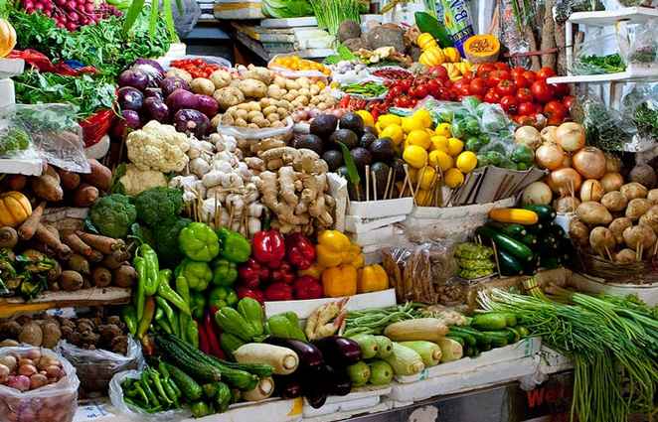
Notes:
But what happens if people are in different roles. I don’t need anyone to bring me food. So does that mean I have no responsibility to bring food to anyone else, even my children?

Slide 5
Free software?
Notes:
What if not everyone wants what you want. Suppose you are happy to give your software away free. Does this mean you can steal someone else’s? (Tavani, p 48)

Slide 6
Maybe it’s more complex than either
treating people as you want to be treated or
treating people as they want to be treated

